Slide 1
Crop Production Analysis in India Data Analysis
by : ATHULYA P

Slide 2
Problem Statement The Agriculture business domain, as a vital part of the overall supply chain, is expected to highly evolve in the upcoming years via the developments, which are taking place on the side of the Future Internet. This paper presents a novel Business-to-Business collaboration platform from the agri-food sector perspective, which aims to facilitate the collaboration of numerous stakeholders belonging to associated business domains, in an effective and flexible manner. This dataset provides a huge amount of information on crop production in India ranging from several years. Based on the Information the ultimate goal would be to predict crop production and find important insights highlighting key indicators and metrics that influence crop production. Make views and dashboards first and make a story out of it.

Slide 3
Introduction In recent years, the agriculture sector has witnessed significant advancements driven by technology and data-driven approaches. One of the critical components of this transformation is the analysis of crop production data, which provides valuable insights into agricultural practices, productivity, and the factors influencing crop yields. This document focuses on the analysis of crop production data pertaining to India, a country with a diverse agricultural landscape and a significant contribution to global food production. The dataset used for this analysis contains extensive information on crop production across different states and districts over multiple years. The analysis aims to uncover key trends, patterns, and factors affecting crop production in India. By leveraging Python programming language and various data analysis libraries, we seek to provide actionable insights that can inform decision-making processes in the agricultural domain. Through this analysis, stakeholders such as policymakers, agricultural researchers, and farmers can gain a deeper understanding of crop production dynamics, identify areas for improvement, and optimize agricultural practices for enhanced productivity and sustainability. Furthermore, this document serves as a guide for conducting similar analyses on crop production data, demonstrating the power of data-driven approaches in addressing challenges and driving innovation in the agriculture sector.

Slide 4
Analysis Approach 1. Data Understanding: Dataset Overview: Begin by understanding the structure and content of the dataset. This includes examining the columns, data types, and any missing values. Domain Knowledge: Gain insights into the agricultural domain, including key factors affecting crop production such as climate, soil quality, and farming practices. 2. Data Preprocessing: Handling Missing Values: Address any missing or incomplete data by either removing rows with missing values or imputing them using appropriate techniques. Data Cleaning: Check for any inconsistencies or errors in the data and correct them if necessary. Feature Engineering: Create new features or transform existing ones to extract valuable information for analysis. 3. Exploratory Data Analysis (EDA): Descriptive Statistics: Compute summary statistics to understand the central tendency, variability, and distribution of key variables such as crop production, area under cultivation, etc. Visualizations: Create visual representations of the data using plots such as line plots, bar charts, and histograms to identify trends, patterns, and relationships.

Slide 5
4. Feature Selection: Identify Relevant Features: Determine which features are most relevant for predicting crop production. This may involve analyzing correlations, feature importance scores, or domain knowledge. Dimensionality Reduction: Apply techniques such as PCA (Principal Component Analysis) or feature selection algorithms to reduce the dimensionality of the dataset if necessary. 5. Modeling: Model Selection: Choose appropriate machine learning models for predicting crop production based on the nature of the problem (e.g., regression for continuous prediction). Model Training: Split the dataset into training and testing sets and train the selected models on the training data. Model Evaluation: Evaluate the performance of the trained models using appropriate evaluation metrics such as RMSE (Root Mean Squared Error), MAE (Mean Absolute Error), etc. 6. Interpretation and Insights: Interpret Model Results: Analyze the coefficients or feature importance scores of the trained models to understand the factors influencing crop production. Generate Insights: Draw actionable insights from the analysis, such as identifying the most influential factors, seasonal trends, and areas for improvement in agricultural practices. Recommendations: Provide recommendations based on the insights gained to optimize crop production, enhance agricultural productivity, and address challenges in the agriculture sector.

Slide 6
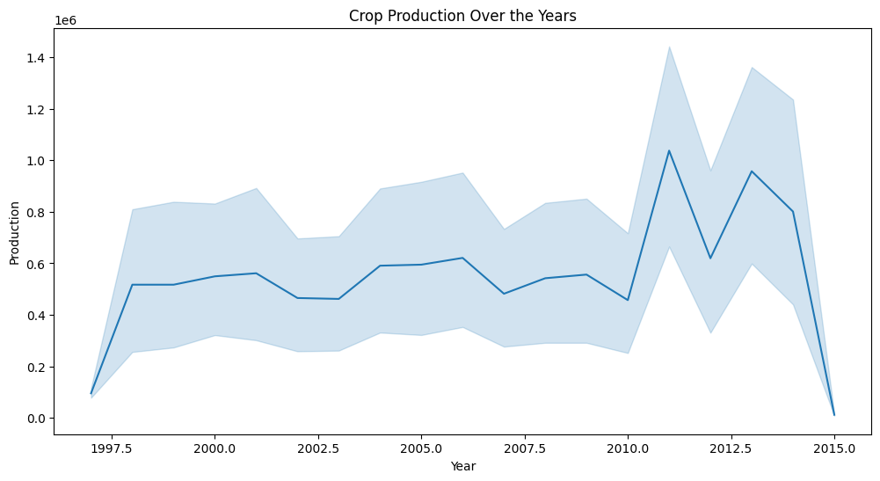

Slide 7
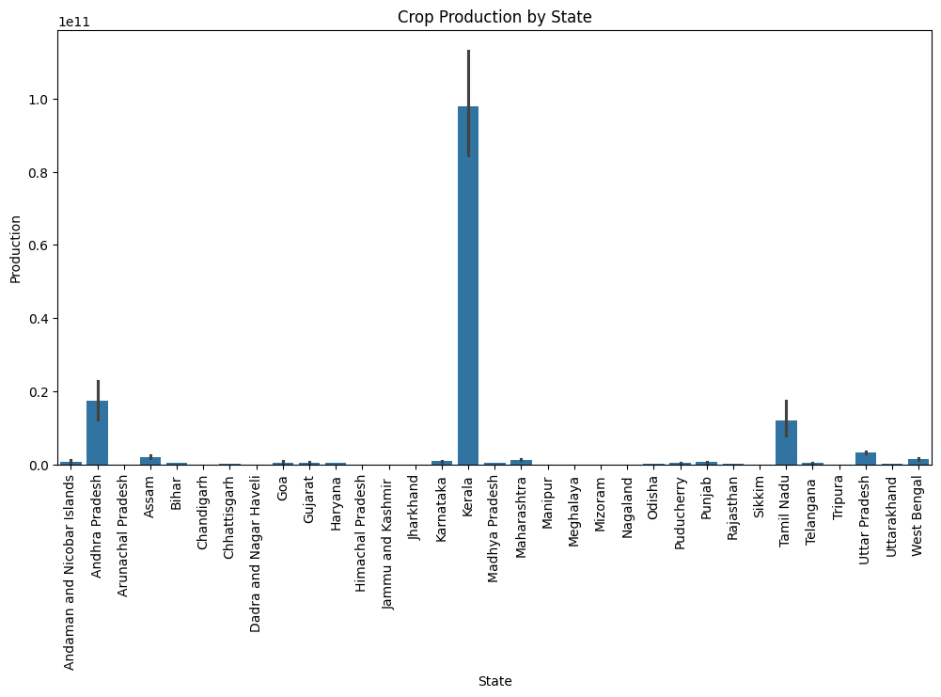

Slide 8
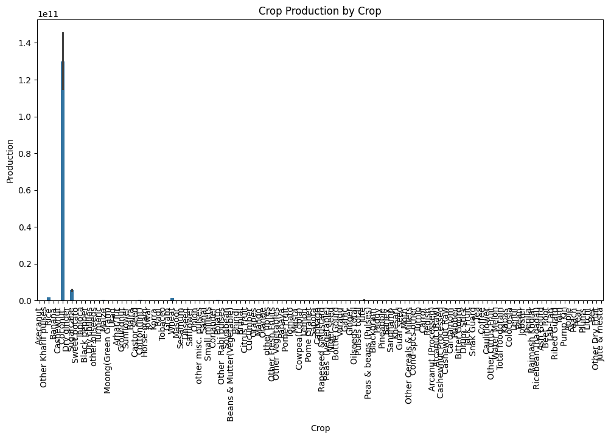
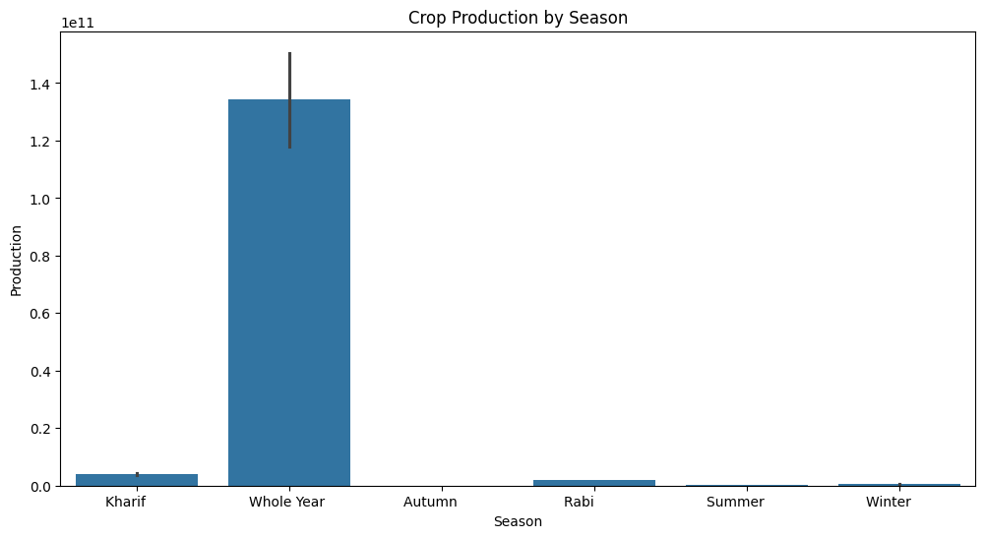

Slide 9
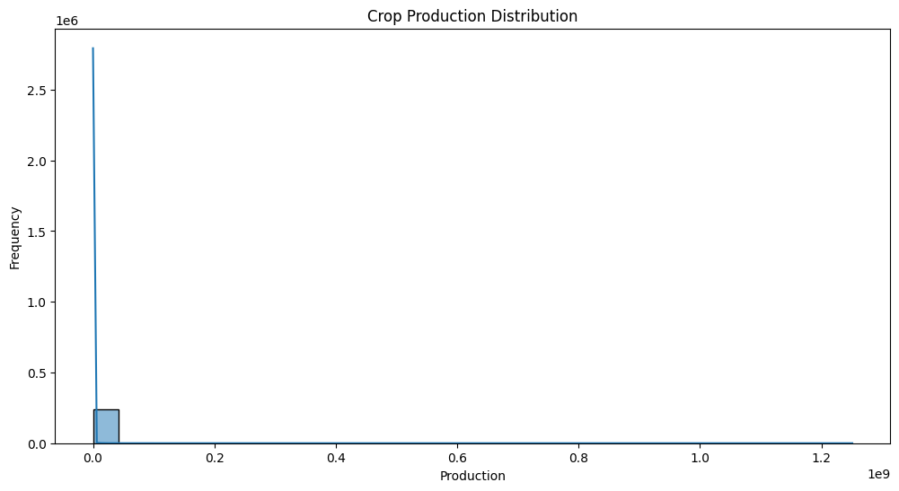

Slide 10
Conclusion In conclusion, the analysis of crop production data using Python has provided valuable insights into agricultural practices and productivity in India. By examining trends, patterns, and key factors influencing crop production, we have gained a deeper understanding of the dynamics of the agriculture sector. Through this analysis, we have identified opportunities for optimizing agricultural practices, improving productivity, and addressing challenges faced by farmers. The findings highlight the importance of data-driven approaches in informing decision-making processes and driving innovation in the agriculture domain. Moving forward, it is essential to continue leveraging data analysis techniques to monitor crop production trends, identify emerging issues, and implement targeted interventions for sustainable agricultural development. By collaborating with stakeholders across the agricultural value chain, we can work towards enhancing food security, promoting agricultural resilience, and fostering economic growth in rural communities.

